Slide 1

Gene expression classifiers for relapse - free survival risk classification and outcome prediction in pediatric B - precursor acute lymphoblastic leukemia
October 31, 2017
Mario Barbé, Olga Better, Peilin Chen, Sha Yu

Slide 2
Introduction
NIH projects medical spending on cancer 200 billions dollars by 2020.
More funds for research
Cancer in child has a tremendous impact
Family
Society → increase disability-adjusted life years.
Most frequent children's cancer → Acute Leukemia
Lymphocytic variant (ALL)
B cell or T cell

Slide 3
Introduction
ALL subtypes
B-cell ALL
Early pre-B (pro-B) ALL 10%
Common ALL 50%
Pre-B ALL 10%
Mature B-cell ALL (Burkitt leukemia) 4%
T-cell ALL
Pre-T ALL 5-10%
Mature T-cell ALL 15-20%

Slide 4
Introduction
Clinical presentation
Pallor
Bruising
Fever
Enlarged liver and or spleen

Slide 5
Introduction
ALL Clinical trials classification differs depending on the research group :
Berlin-Frankfurt-Münster (BFM)
Treatment response
Prednisone prophase response
Minimal residual disease (MRD)
End induction phase (week five)
End consolidation phase (week 12)
The Children’s Oncology Group (COG)
Age 1 to < 10
White blood cell count at diagnosis <50,000 cells/uL
MRD at the end of the induction phase (day 29)
Compromise of testes and / or CNS
Presence intrachromosomal amplification or extreme hyperploidy

Slide 6
Introduction
Some groups experience 75-80% five-year-event-free-survival
Probably we are mixing different type of patients
Over treat: increasing the risk of adverse event
Under treat: reducing the chances of remission
Research
Gene expression
JAK mutation in high-risk patients similar to Phi+ ALL
Hispanic/Latino associated rearrangement in CRLF2, JAK kinases mutations
Deep Whole-exome sequencing → insights why patients relapse
Genome-wide DNA copy number abnormalities → novel cluster groups that may used for diagnosis, risk classification, and therapy.

Slide 7
Introduction
DNA copy number and deep whole-exome not routinely used in clinical practice.
Gene expression technology in widely available in clinical practice.
We aim to reproduce Kang methodology to analyze gene expression data:
Develop COX-regression model based on PCA of gene expression’s COX-score.
Using open source software.
Compare results.

Slide 8
Methodology
Gene expression data
FTP Download of CEL files from TARGET ALL repository
Read files and normalize →
Apply robust multi-array average (RMA)
Filter probes
Exhibiting little variation
Consistently low signal across the samples
Clinical data
FTP Download
Merge with Gene expression data set

Slide 9
Results
207 CELL files (207 patients)
After RMA, we obtained for each patient 54,675 probes (data frame 54,675 rows and 207 columns).
After filtering process, we ended up with 21,148 probes per patient. (Kang et al 23,775).

Slide 10
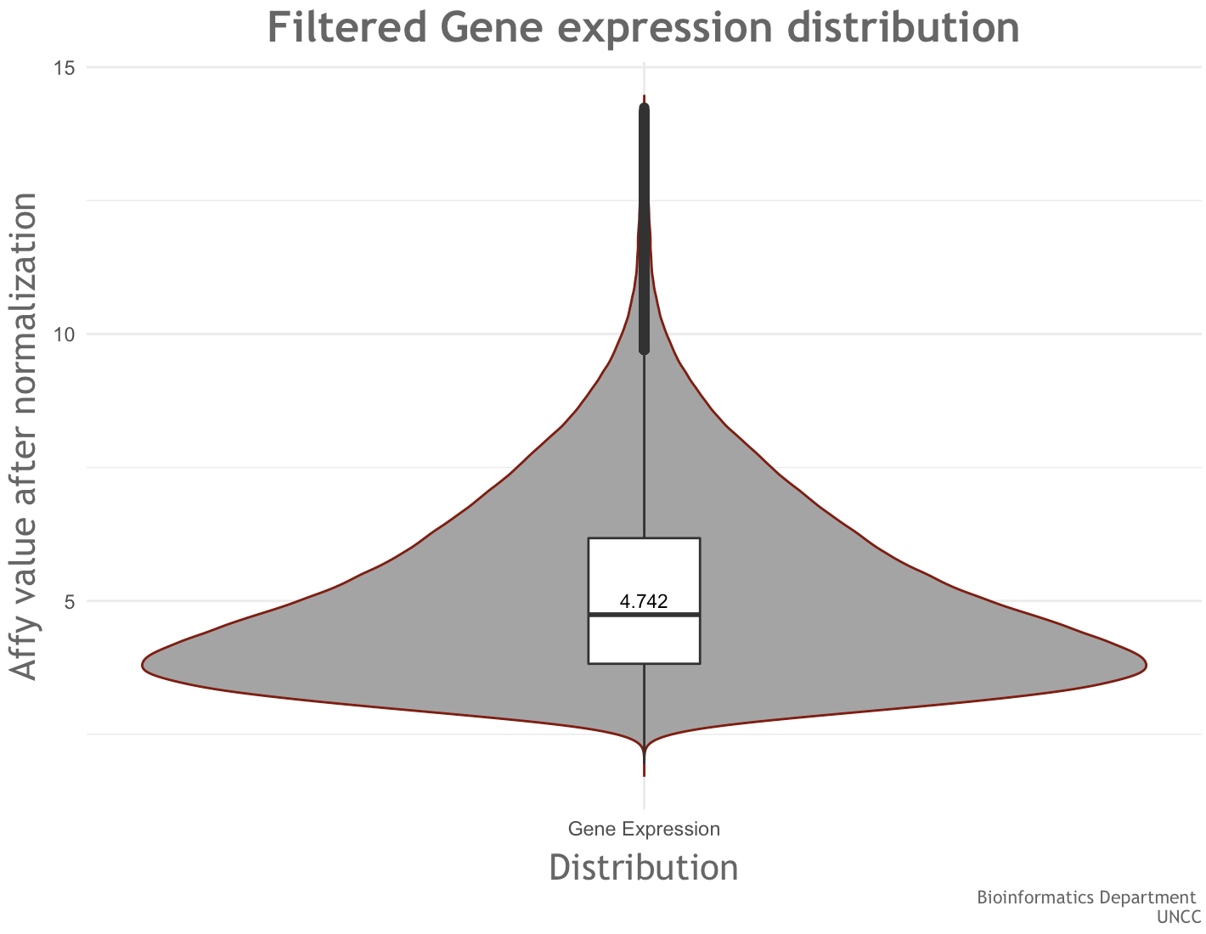
Results

Slide 12
References
1. Cancer costs projected to reach at least $158 billion in 2020. 2015 2015-07-23 2017-09-10]; Available from: https://www.ncbi.nlm.nih.gov/pubmed/.
2. Dores, G.M., et al., Acute leukemia incidence and patient survival among children and adults in the United States, 2001-2007. Blood, 2012. 119(1): p. 34-43.
3. WHO | Disability-adjusted life years (DALYs). WHO 2017 2017-01-27 15:23:13 2017-09-10]; Available from: http://www.who.int/gho/mortality_burden_disease/daly_rates/text/en/.
4. WHO | Metrics: Disability-Adjusted Life Year (DALY). WHO 2014 2014-03-11 14:56:00 2017-09-10]; Available from: http://www.who.int/healthinfo/global_burden_disease/metrics_daly/en/.
5. Ward, E., et al., Childhood and adolescent cancer statistics, 2014. CA Cancer J Clin, 2014. 64(2): p. 83-103.
6. Svendsen, A.L., et al., Time trends in the incidence of acute lymphoblastic leukemia among children 1976-2002: a population-based Nordic study. J Pediatr, 2007. 151(5): p. 548-50.
7. NIH Categorical Spending -NIH Research Portfolio Online Reporting Tools (RePORT). 2017 2017-09-10]; Available from: https://report.nih.gov/categorical_spending.aspx.
8. Kang, H., et al., Gene expression classifiers for relapse-free survival and minimal residual disease improve risk classification and outcome prediction in pediatric B-precursor acute lymphoblastic leukemia. Blood, 2010. 115(7): p. 1394-405.
9. Conter, V., et al., Molecular response to treatment redefines all prognostic factors in children and adolescents with B-cell precursor acute lymphoblastic leukemia: results in 3184 patients of the AIEOP-BFM ALL 2000 study. Blood, 2010. 115(16): p. 3206-14.
10. Schultz, K.R., et al., Risk- and response-based classification of childhood B-precursor acute lymphoblastic leukemia: a combined analysis of prognostic markers from the Pediatric Oncology Group (POG) and Children's Cancer Group (CCG). Blood, 2007. 109(3): p. 926-35.
11. Koo, H.H., Philadelphia chromosome-positive acute lymphoblastic leukemia in childhood. Korean J Pediatr, 2011. 54(3): p. 106-10.
12. Moricke, A., et al., Risk-adjusted therapy of acute lymphoblastic leukemia can decrease treatment burden and improve survival: treatment results of 2169 unselected pediatric and adolescent patients enrolled in the trial ALL-BFM 95. Blood, 2008. 111(9): p. 4477-89.
13. Moghrabi, A., et al., Results of the Dana-Farber Cancer Institute ALL Consortium Protocol 95-01 for children with acute lymphoblastic leukemia. Blood, 2007. 109(3): p. 896-904.
14. Veerman, A.J., et al., Dexamethasone-based therapy for childhood acute lymphoblastic leukaemia: results of the prospective Dutch Childhood Oncology Group (DCOG) protocol ALL-9 (1997-2004). Lancet Oncol, 2009. 10(10): p. 957-66.
15. Mullighan, C.G., et al., JAK mutations in high-risk childhood acute lymphoblastic leukemia. Proc Natl Acad Sci U S A, 2009. 106(23): p. 9414-8.
16. Harvey, R.C., et al., Rearrangement of CRLF2 is associated with mutation of JAK kinases, alteration of IKZF1, Hispanic/Latino ethnicity, and a poor outcome in pediatric B-progenitor acute lymphoblastic leukemia. Blood, 2010. 115(26): p. 5312-21.
17. Harvey, R.C., et al., Identification of novel cluster groups in pediatric high-risk B-precursor acute lymphoblastic leukemia with gene expression profiling: correlation with genome-wide DNA copy number alterations, clinical characteristics, and outcome. Blood, 2010. 116(23): p. 4874-84.
18. Zhang, J., et al., Key pathways are frequently mutated in high-risk childhood acute lymphoblastic leukemia: a report from the Children's Oncology Group. Blood, 2011. 118(11): p. 3080-7.
19. Gautier, L., et al., affy--analysis of Affymetrix GeneChip data at the probe level. Bioinformatics, 2004. 20(3): p. 307-15.
20. Hahne, R.G.a.V.C.a.W.H.a.F., genefilter: genefilter: methods for filtering genes from high-throughput experiments. 2017.
21. Gentleman, R., annotate: Annotation for microarrays. 2017.
22. Bair, E., et al., Prediction by Supervised Principal Components. Journal of the American Statistical Association, 2006. 101(473): p. 119-137.
23. Childhood Acute Lymphoblastic Leukemia Treatment (PDQ®)—Health Professional Version - National Cancer Institute. 2017 2017-10-25]; Available from: https://www.cancer.gov/types/leukemia/hp/child-all-treatment-pdq - link/_580_toc.

